Slide 1
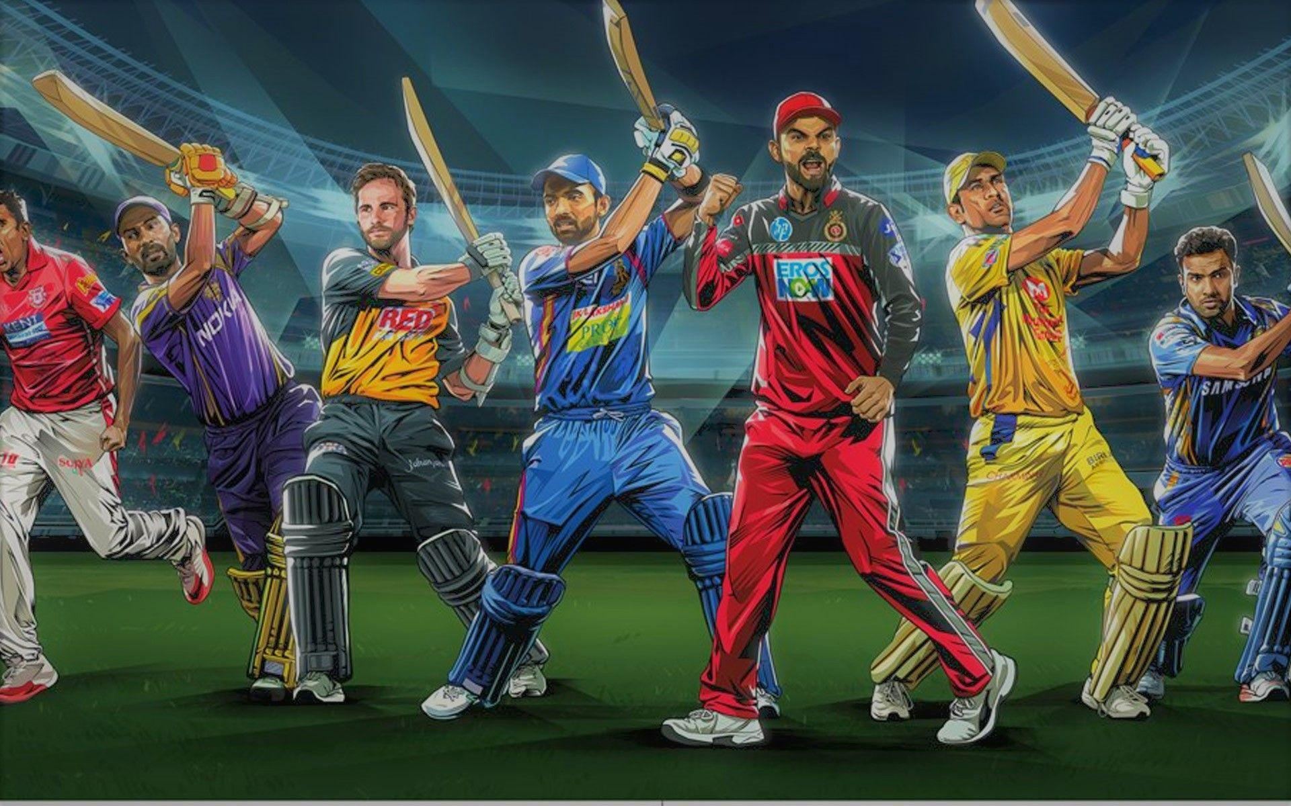
SQL Project
IPL auction strategy

Slide 2
Motive
Presenting auction strategy for new IPL franchise by analyzing past IPL data to create a balanced squad.

Slide 3
Creating Deliveries table & Importing data from CSV:
CREATE TABLE Deliveries (id int, inning int, over int, ball int, batsman varchar, non_striker varchar, bowler varchar, batsman_runs int, extra_runs int, total_runs int, is_wicket int, dismissal_kind varchar, player_dismissed varchar, fielder varchar, extras_type varchar, batting_team varchar, bowling_team varchar);
COPY Deliveries (id, inning, over, ball, batsman, non_striker, bowler, batsman_runs, extra_runs, total_runs, is_wicket, dismissal_kind, player_dismissed, fielder, extras_type, batting_team, bowling_team)
FROM 'E:\Data Science with python\SQL\Project\IPL Dataset\IPL Dataset\IPL_ball.csv' DELIMITER ',' CSV HEADER;
Creating matches table & Importing data from CSV:
CREATE TABLE Matches (id int, city varchar, date varchar, player_of_match varchar, venue varchar, neutral_venue int, team1 varchar, team2 varchar, toss_winner varchar, toss_decision varchar, winner varchar, result varchar, result_margin int, eliminator varchar, method varchar, umpire1 varchar, umpire2 varchar);
COPY Matches (id, city, date, player_of_match, venue, neutral_venue, team1, team2, toss_winner, toss_decision, winner, result, result_margin, eliminator, method, umpire1, umpire2)
FROM 'E:\Data Science with python\SQL\Project\IPL Dataset\IPL Dataset\IPL_matches.csv' DELIMITER ',' CSV HEADER;

Slide 4
Bidding on Batsman

Slide 5
Part -1
High strike rate batsman's who have faced at least 500 balls.
SELECT *, ROUND(total_run*100/total_balls::numeric,2) AS Strike_rate FROM
(
SELECT batsman, SUM(batsman_runs) AS total_run, COUNT(ball) AS total_balls
FROM Deliveries
WHERE extras_type <> 'wides’
GROUP BY batsman
) AS nt
WHERE total_balls > '500’
ORDER BY Strike_rate DESC LIMIT 10;
In order to calculate batting strike rate, we must divide the total number of runs scored by batsman in an innings by the number of deliveries faced by a batsman.
This ratio is then multiplied by 100 and it is called the batting strike rate.

Slide 6
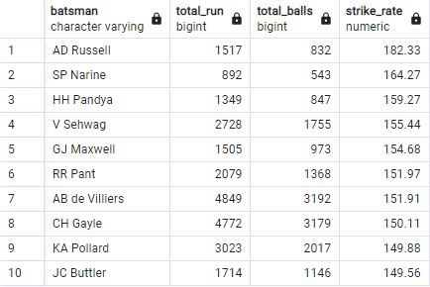
List of top 10 high Strike-rate batsman's:

Slide 7
Visualization - Top 10 high score batsman

Slide 8
Visualization - Top 10 strike rate batsman

Slide 9
Visualization – AD Russell overall performance

Slide 10
Part -2
Good average batsman who have played more than 2 IPL seasons.
SELECT batsman, total_run, times_dismissed, seasons, ROUND(total_run/times_dismissed::numeric,2) AS Average FROM
(
SELECT A.batsman, SUM(A.batsman_runs) AS total_run, SUM(A.is_wicket) AS times_dismissed, COUNT(DISTINCT B.year) AS seasons
FROM Deliveries AS A JOIN
(
SELECT ID, EXTRACT(YEAR FROM TO_DATE(date, 'DD-MM-YYYY')) AS year FROM matches
) AS B
ON A.ID = B.ID GROUP BY A.batsman
)
AS nt WHERE times_dismissed >=1 AND seasons > 2
ORDER BY Average DESC LIMIT 10;
In order to calculate Average of batsman's, we must divide the total runs scored by batsman in an innings by the total number of dismissals of batsman.

Slide 11
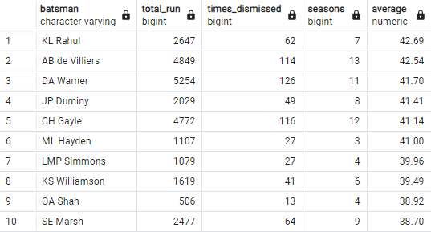
List of top 10 high good average batsman’s:

Slide 12
Visualization – Top 10 good average batsman’s.

Slide 13
Part -3
Hard-hitting batsman who have scored most runs in boundaries.
SELECT batsman, total_Bound_runs, total_runs, Boundaries, ROUND(total_Bound_runs*100/total_runs::numeric,2) AS Boudary_percentage
FROM
(
SELECT A.batsman, SUM(A.batsman_runs) AS total_runs,
SUM(CASE WHEN A.batsman_runs = 4 OR A.batsman_runs = 6 THEN A.batsman_runs END) AS total_Bound_runs,
COUNT(CASE WHEN A.batsman_runs = 4 OR A.batsman_runs = 6 THEN A.batsman_runs END) AS Boundaries,
COUNT(DISTINCT B.Year) AS seasons
FROM Deliveries AS A JOIN
(
SELECT ID, EXTRACT(YEAR FROM TO_DATE(date, 'DD-MM-YYYY')) AS year FROM matches
) AS B ON A.ID = B.ID GROUP BY A.batsman
) AS nt WHERE seasons>2
GROUP BY nt.batsman, nt.Boundaries, nt.total_Bound_runs, nt.total_runs
ORDER BY Boundaries DESC LIMIT 10;
In order to calculate Boundary percentage of batsman's, we must divide the total boundaries runs scored by batsman by the total runs scored by batsman.

Slide 14
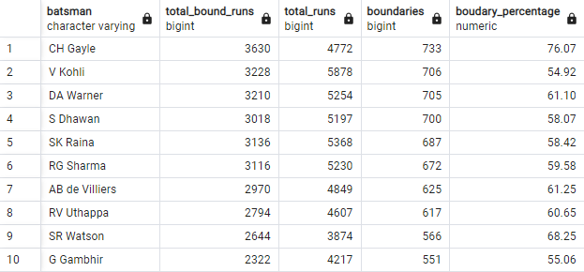
List of top 10 hard-hitting batsman’s:

Slide 15
Visualization – Top 5 hard hitting batsman’s.
These 5 hard hitting batsman can perform an important role in our team as a hard hitting batsman and can make our team strongest.

Slide 16
Bidding on Bowlers

Slide 17
Part -1
Good economy bowlers who have bowled at least 500 balls in IPL
SELECT Bowler, Conceded_runs, overs, ROUND(Conceded_runs/overs::numeric,2) AS Economy FROM
(
SELECT Bowler, SUM(total_runs) AS Conceded_runs,
COUNT(ball) AS total_ball,
ROUND(COUNT(ball)/6::numeric,2) AS overs
FROM Deliveries GROUP BY Bowler
) AS nt
WHERE total_ball >= 500
GROUP BY Bowler, Conceded_runs, total_ball, overs
ORDER BY Economy
LIMIT 10;
In order to calculate bowlers economy, we must divide the total conceded runs given by bowler by number of overs bowled by bowler.

Slide 18
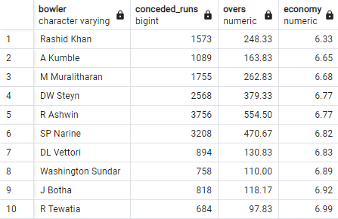
List of top 10 good economy bowlers:

Slide 19
Visualization – Total Conceded runs & balls bowled by each bowler.

Slide 20
Visualization – Top 10 good economy bowlers.
According to economy “Rashid khan” is most important player as a bowler to make a strong team. He can perform an important role in team as a bowler.

Slide 21
Part -2
Best Strike-rate bowlers who have bowled at least 500 balls in IPL
SELECT *, ROUND(total_balls/total_wicket::numeric,2) AS Strike_Rate FROM
(
SELECT Bowler,
COUNT(ball) AS total_balls,
SUM(is_wicket) AS total_wicket
FROM Deliveries GROUP BY Bowler
)
AS nt
WHERE total_balls >= 500
ORDER BY Strike_Rate ASC
LIMIT 10;
In order to calculate bowling strike-rate, we must divide the total balls bowled by bowler by total number of wickets has taken by bowler.

Slide 22
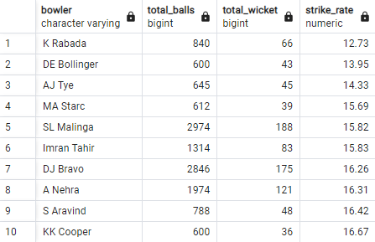
List of top 10 best strike rate bowlers:

Slide 23
Visualization – Top 10 best strike-rate bowlers.
According to Strike rate “K Rabada” is most important player as a bowler to make a strong balanced team. He can perform an important role in team as a bowler.

Slide 24
K Rabada wicket taking percentage.
According to Strike rate “K Rabada” is most important players as a bowler to make a strong balanced team. He can perform an important role in team as a bowler.

Slide 25
Bidding for All Rounders

Slide 26
Creating a view, containing data related to bowlers.
CREATE VIEW bowler_data AS
SELECT bowler,
COUNT(ball) AS ball_bowled,
SUM(is_wicket) AS total_wicket
FROM Deliveries
GROUP BY bowler;
Creating a view, containing data related to batters.
CREATE VIEW batsman_data AS
SELECT batsman,
SUM(batsman_runs) AS tot_bats_runs,
COUNT(ball) AS ball_faced
FROM Deliveries
WHERE extras_type <> 'wides'
GROUP BY batsman;

Slide 27
All Rounders
Best batting & bowling strike-rate who have faced at least 500 balls in IPL & have bowled minimum 300 balls.
SELECT A.bowler AS Players,
B.tot_bats_runs*100/B.ball_faced AS Bat_strike_rate,
ROUND(A.ball_bowled/A.total_wicket::numeric,2) AS ball_strike_rate
FROM bowler_data AS A
INNER JOIN batsman_data AS B
ON A.bowler = B.batsman
WHERE B.ball_faced >= 500 AND A.ball_bowled >=300
GROUP BY A.bowler, B.tot_bats_runs, B.ball_faced, A.ball_bowled, A.total_wicket
ORDER BY Bat_strike_rate DESC, ball_strike_rate
LIMIT 10;
Already mentioned the criteria of calculation the batting & bowling strike rate in previous topics.

Slide 28
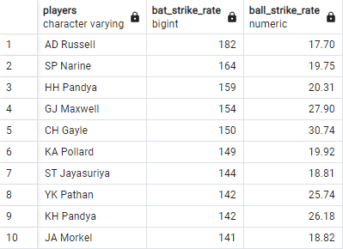
List of top 10 best all rounders according to batting & balling strike-rate:

Slide 29
Visualization – Top 10 all rounders according to bowling strike-rate.
“AD Russell, ST Jayasuriya, JA Morkel” these are the important players According to bowling Strike rate.

Slide 30
Visualization – Top 10 all rounders according to batting strike-rate.
“AD Russell, SP Narine, HH Pandya” these are the important players According to batting Strike rate.

Slide 31
Top 3 players performance according to batting and bowling Strike rate.
According to batting S.R
According to Bowling S.R
“AD Russell is the only common player who is the best in both bowing & batting Strike-rate.”

Slide 32
Criteria for Wicket-keeper
A wicketkeeper needs to be alert for every single ball of the innings, adapt to the pace and lengths of the bowlers, and stand tall in all weather conditions while wearing heavy gear.
I would like to chose those two players for wicket keeper whose fielding accuracy is excellent.
Those players must be a agile & fit so that he can’t miss any ball & important catches & eligible to stump the batsman in speed.
Those players must be full of strength and energy (that allow you to sustain physical or mental effort for long periods of time).
Those players must be a hard-hitting batsman & should have decent batting Strike rate & decent bowling (Spin or Medium pace) skills also.

Slide 33
Additional Questions-
1.) Cities that have hosted IPL matches:
SELECT City,
COUNT(city) AS No_of_match_hosted
FROM matches
GROUP BY city
ORDER BY No_of_match_hosted DESC;

Slide 34
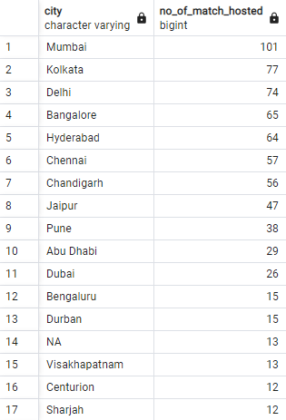
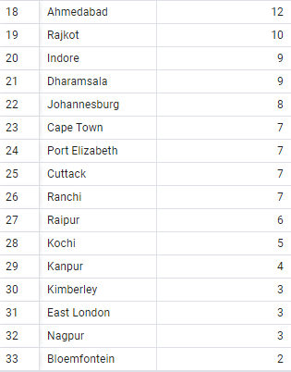
Output: Cities list that have hosted IPL matches

Slide 35
Visualization – Top 10 cities that have hosted IPL matches.

Slide 36
2.) Create table deliveries_v02.
CREATE TABLE deliveries_v02 AS
SELECT *,
CASE WHEN total_runs >=4 THEN 'Boundary’
WHEN total_runs =0 THEN 'Dot’ ELSE 'Other’ END
AS ball_result
FROM deliveries;
3.) Fetching total number of boundaries and Dot balls.
SELECT ball_result,
COUNT(ball_result) AS Total_count
FROM deliveries_v02
WHERE ball_result <>'Other’
GROUP BY ball_result;

Slide 37

Total number of Boundaries and Dot balls
Output:
Visualization:

Slide 38
4.) Total number of boundaries scored by each team.
SELECT batting_team,
COUNT(ball_result) AS tot_no_of_Boundary
FROM deliveries_v02
WHERE ball_result ='Boundary’
GROUP BY batting_team
ORDER BY tot_no_of_Boundary DESC;

Slide 39
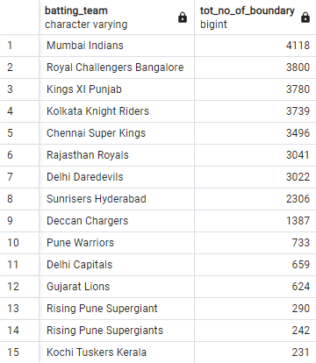
Output: Total number of boundaries scored by each team

Slide 40
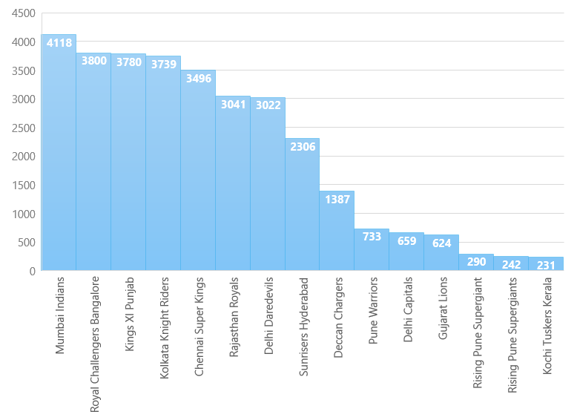
Visualization: Total number of boundaries scored by each team

Slide 41
5.) Total number of Dot balls bowled by each team.
SELECT batting_team,
COUNT(ball_result) AS tot_no_of_Boundary
FROM deliveries_v02
WHERE ball_result ='Boundary’
GROUP BY batting_team
ORDER BY tot_no_of_Boundary DESC;

Slide 42
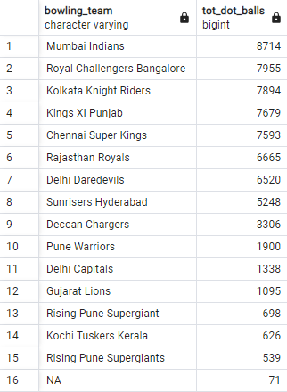
Output: Total number of dot balls bowled by each team.

Slide 43
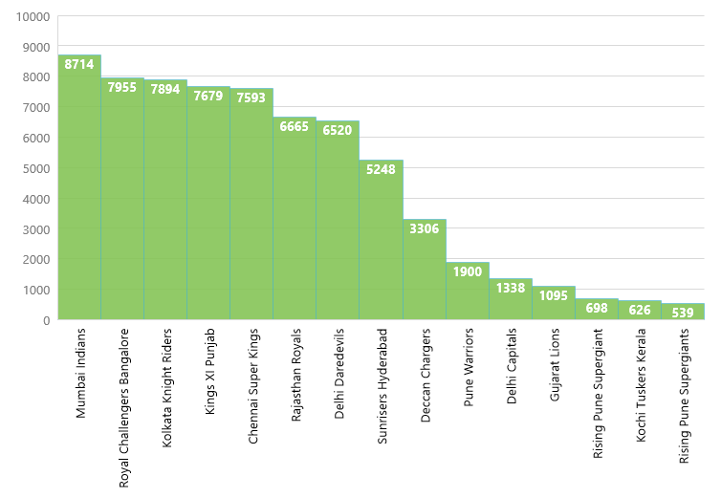
Visualization: Total number of dot balls bowled by each team.

Slide 44
6.) Total number of dismissals by dismissal kinds.
SELECT dismissal_kind,
COUNT(dismissal_kind) AS No_of_dismissals
FROM deliveries_v02
WHERE dismissal_kind <> 'NA’
GROUP BY dismissal_kind;

Slide 45
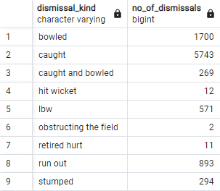
Output: Total number of dismissals by dismissal kinds.

Slide 46
Visualization: Total number of dismissals by dismissal kinds..
Category of Higher dismissals between 250-5800
Category of lower dismissals between 2 - 15

Slide 47
7.) Top 5 bowlers who conceded max. extra runs.
SELECT bowler,
SUM(extra_runs) AS Extra_Runs
FROM Deliveries
GROUP BY bowler
ORDER BY Extra_Runs DESC
LIMIT 5;
8.) Creating table deliveries_V03.
CREATE TABLE deliveries_v03 AS
SELECT A.*,
B.venue AS venue,
date AS match_date
FROM deliveries_v02 AS A LEFT JOIN matches AS B
ON A.id = B.id;

Slide 48
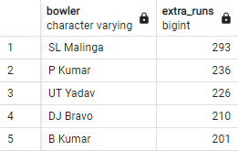
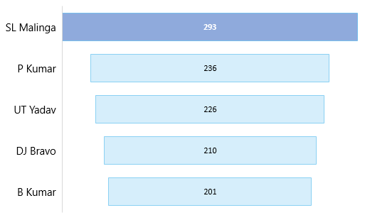
Top 5 bowlers who conceded max. extra runs
Output:
Visualization:

Slide 49
9.) Total runs scored by each venue.
SELECT venue,
SUM(total_runs) AS total_Runs
FROM deliveries_v03
GROUP BY venue
ORDER BY total_runs DESC;

Slide 50
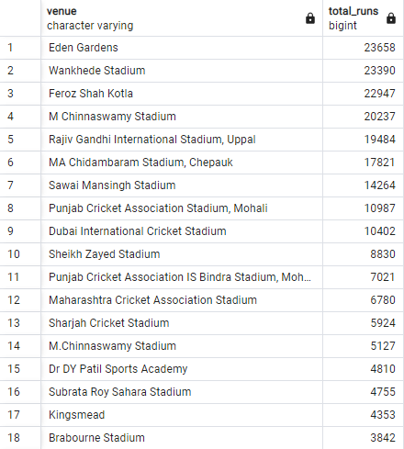
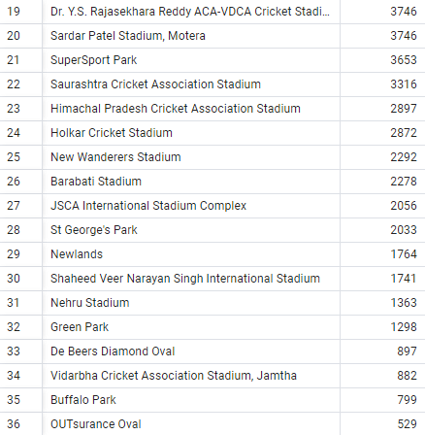
Output: Total runs scored by each venue.

Slide 51
Visualization:
Top Venue’s on which b/w 5,000 – 25,000 runs has been scored.
Eden Gardens is the only ground where most runs have been scored. 23658 runs has been scored at “Eden Garden”.

Slide 52
Visualization:
Top 4 Venue’s on which more than 20,000 runs has been scored.

Slide 53
10.) Total runs scored at Eden Gardens (Year-wise).
SELECT venue,
SUBSTRING(match_date FROM 7 FOR 4) AS Year,
SUM(total_runs) AS total_runs
FROM deliveries_v03
WHERE venue = 'Eden Gardens’
GROUP BY year, venue
ORDER BY total_runs DESC;

Slide 54
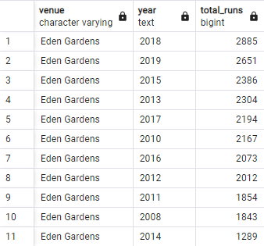
Output: Total runs scored at Eden Gardens (Year-wise).

Slide 55
Visualization: Total runs scored at Eden Gardens (Year-wise)
According to chart, at “Eden Gardens” Runs are continuously increasing year by year. We can see the increment clearly according to trend line.

Slide 56
Thanks' for viewing my presentation .

